Slide 2
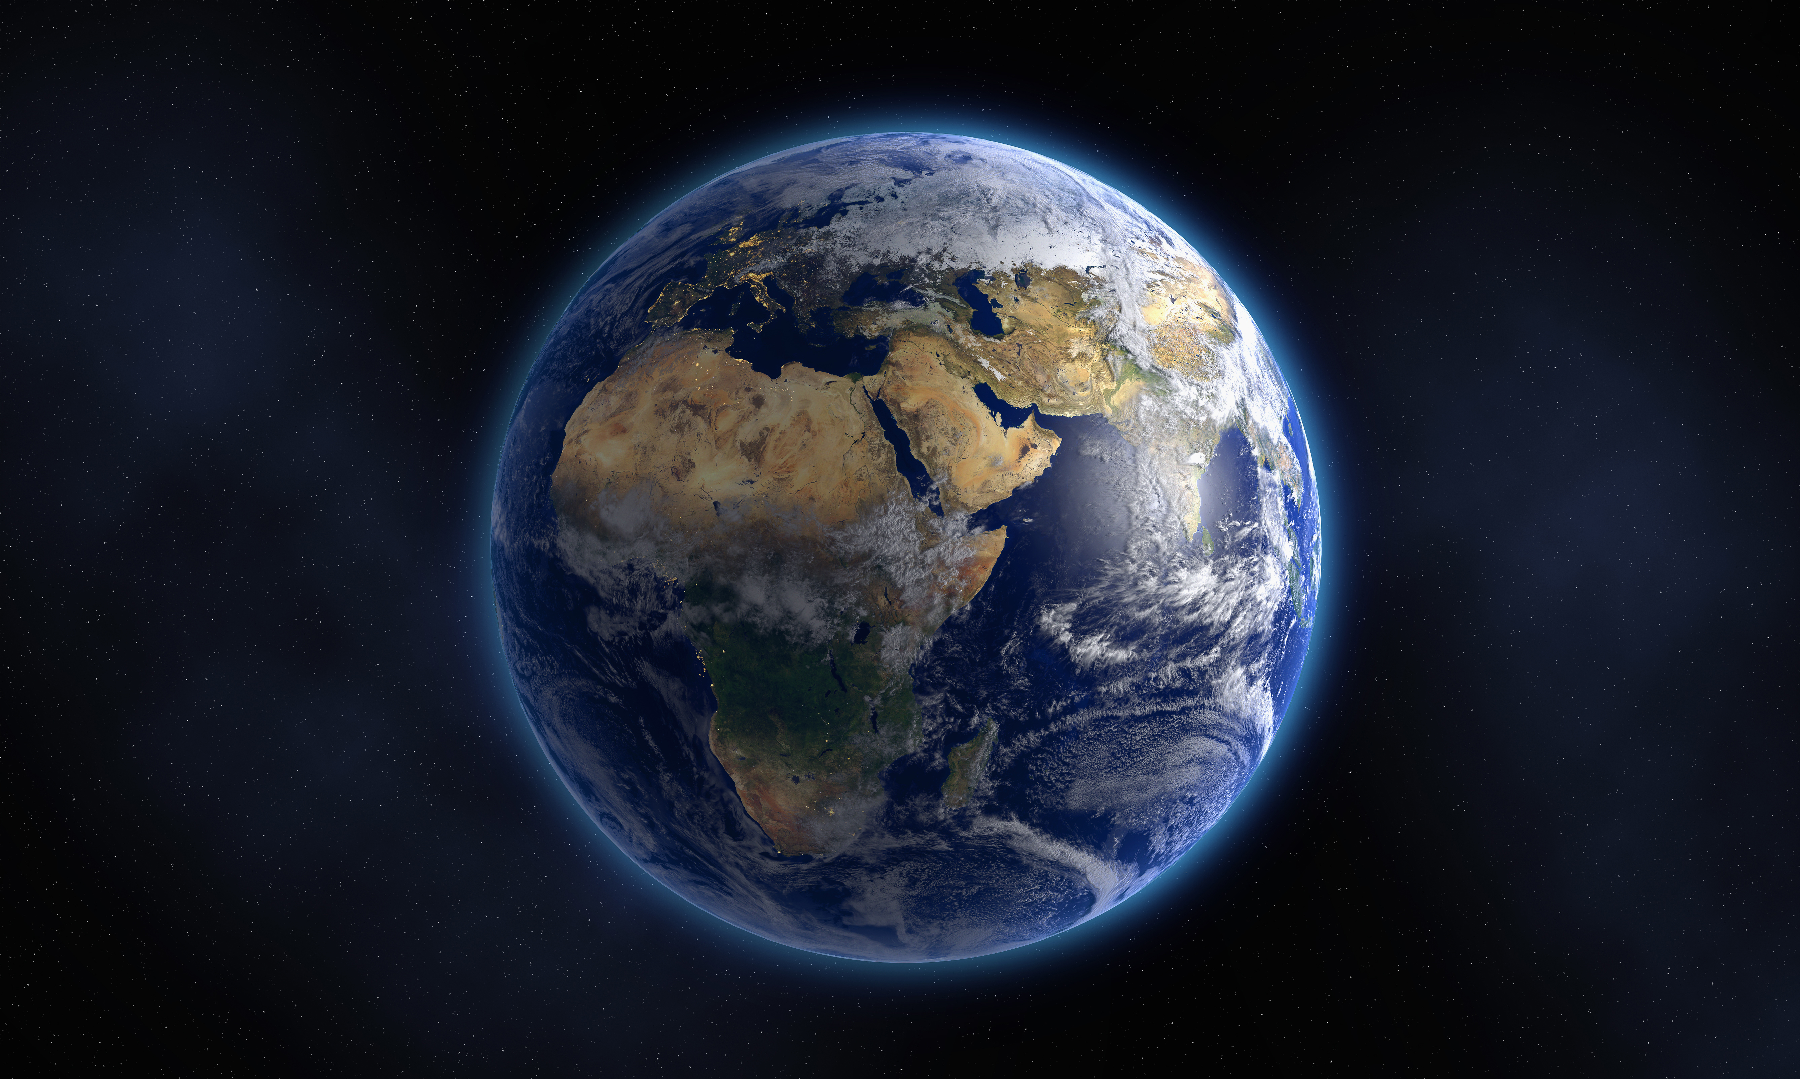
“The heavens declare the glory of God; And the firmament shows His handiwork.” Psalm 19:1

Slide 3
GOD
אֱלֹהִים Elohim - God (plural of majesty: plural in form but singular in meaning, with a focus on great power)
The Bible never tries to PROVE the existence of God! Genesis 1:1
He is presented as FIRST CAUSE of ALL THINGS!
Exodus 3:13-15 “I AM has sent me to you”
Psalm 139:6 “Such knowledge is too wonderful for me; It is high, I cannot attain it.”

Slide 4
“GOD is dead!”
Psalm 2:1-4 “He sits in the heavens shall laugh; The Lord shall hold them in derision.”
Many ACTING like GOD IS DEAD!
They will recognize TOO LATE that He indeed is the CREATOR of ALL THINGS!
Hebrews 3:4 “He who built all things is God.”

Slide 5
GOD’S CHARACTER
Fail to HONOR HIM as the LORD of their LIVES!
THREE DISTINGISHING CHARACTERISTICS OF GOD:
      GOOD
          SEVERE
                EXACT

Slide 6
GOODNESS OF GOD
Giving His Son on the cross – John 3:16
He makes no distinction in the bestowal of material of physical blessings – Matthew 5:44,45; James 1:17
The provision of a PLAN whereby man can be SAVED- Ephesians 2:8,9; Mark 16:15,16
No one can deny the GOODNESS OF GOD!

Slide 7
Severity of god
Romans 11:22 “severity of God: on those who fell, severity…”
Matthew 10:28 “fear Him who is able to destroy both soul and body in hell.”
Hebrews 12:29 “Our God is a consuming fire.”

Slide 8
Severity of god
Examples:
In the Flood – all things destroyed from earth except Noah, his family, and animals carried with them – Genesis 6:1-7
Nadab & Abihu – Leviticus 10:1,2
Sodom & Gomorrah- Genesis 19:13,24
Today – 2 Thessalonians 1:7-10
Romans 11:22- God shows His severity

Slide 9
exactness of god
Examples of additions & substitutions made by men:
Sprinkling for Baptism – Colossians 2:12
Faith Only for Salvation for Faith accompanied by Works Of Obedience- James 2:24
Playing on mechanical instruments of music in worship to God, when God specifies Singing – Ephesians 5:19

Slide 10
Not enough to “know of god”
Not enough to Believe in God
Only when we OBEY God!
Why not BECOME A CHILD OF GOD TODAY?
If you are, but have become stubborn and rebellious to Him, why not REPENT and RETURN TO HIM before it is TOO LATE!

